Slide 1


ACT® Aspire®
Test Administration Training
Notes:
Welcome to the ACT Aspire Test Administration training. This training addresses the steps required for ACT Aspire assessment preparation, test delivery, and post-test cleanup. We recommend this training be viewed by Administration Test Coordinators and Test Coordinators, but anyone involved in test administration is welcome to view this webinar.

Slide 2





Agenda
Accessing and Navigating
Resources
ACT Aspire Testing Process
Paper Testing Process
Online Testing Process
Notes:
We’re going to cover:
Accessing and Navigating PearsonAccess^{next} (note that this will be a brief overview, because we cover this in more depth in the ACT Aspire Technical Readiness for Online Testing webinar)
Resources for ACT Aspire testing
And the ACT Aspire testing process.
We’re going to cover both paper and online testing processes. Note the symbols on the screen designating paper vs. online process steps. We use these symbols throughout the webinar to indicate which steps apply to which administration type.

Slide 3

PearsonAccess^{Next}
Notes:
We’re going to cover some of the basics of accessing and navigating PearsonAccess^{next}.
Screenshots displayed in this training may not be exactly as you see them on your screen as they come from our testing environment, or it may be due to the PearsonAccess^{next} role you were assigned.

Slide 4
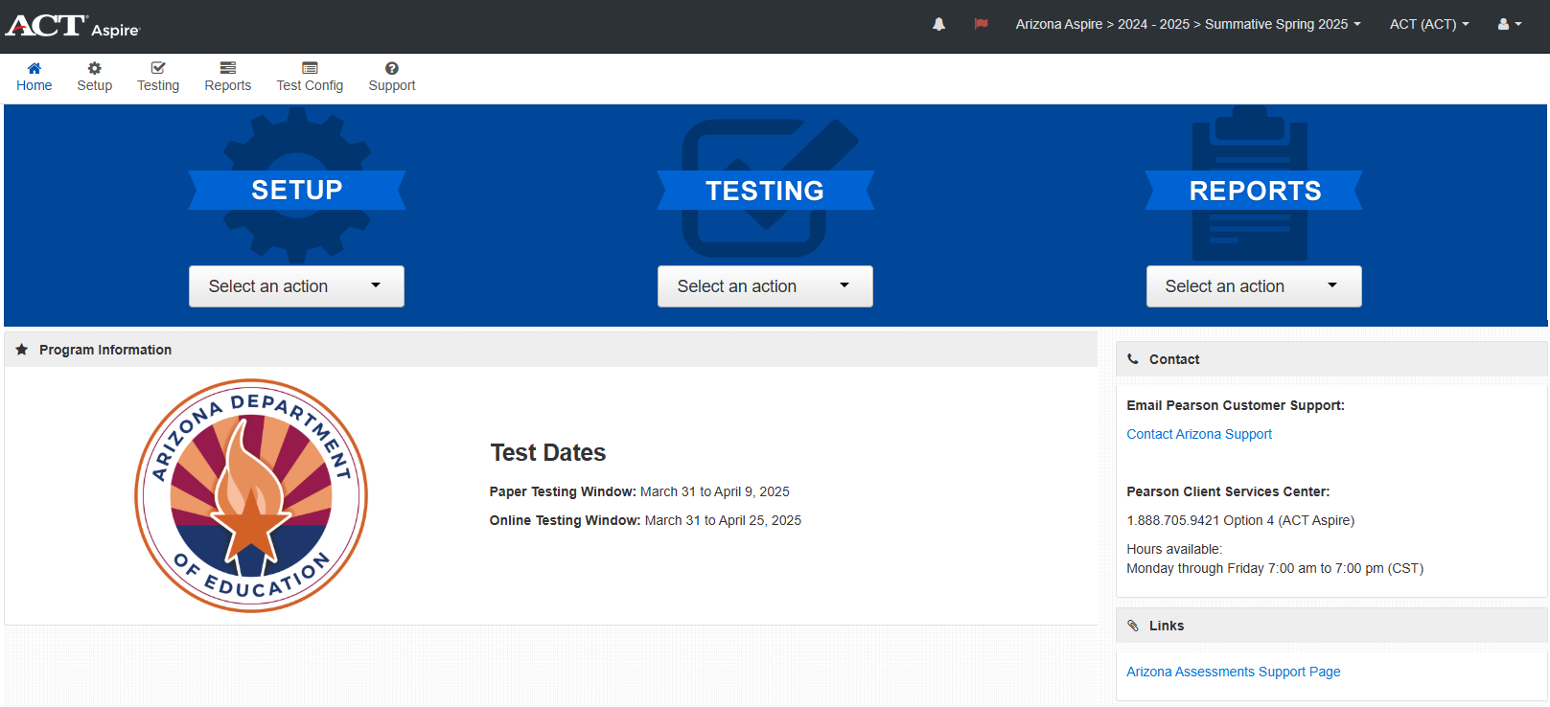
Accessing and Navigating
navigating PearsonAccess^{next}
Main menus
Notes:
On the main page there are three main menus: Setup, Testing, and Reports.
On the home screen they can be accessed from the middle or the top left of the page.
Either way, they contain the same options.

Slide 5
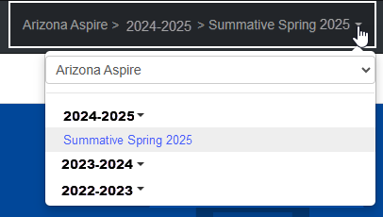
Accessing and Navigating
Changing administrations
Notes:
To navigate between multiple administration years, open the Administration dropdown menu and click the desired administration year.
One other thing to note throughout the webinar: the screenshots we’ve included are samples based on what an Assessment Test Coordinator will see. The critical steps for navigation are accurately represented in this webinar’s slides, but it’s okay if things look slightly different for you than they do here.

Slide 6
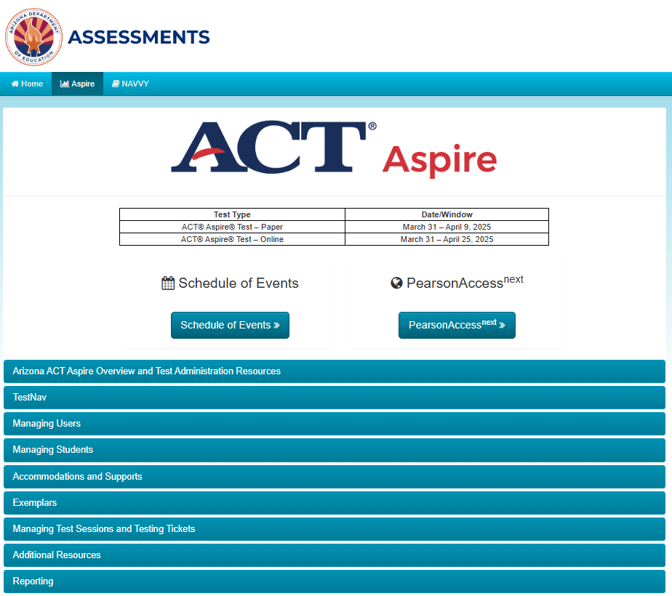

ACT Aspire Resources
https://az-support.mypearsonsupport.com/aspire/
Notes:
Now, let’s talk about ACT Aspire resources. The Arizona ACT Aspire Support Page is your source for test administration manuals, tutorials, and additional resources. We recommend starting with the Schedule of Events document posted on the Support Page.
You can find the Arizona ACT Aspire Support Page at the link provided on this slide.

Slide 7
ACT Aspire Testing Process
Notes:
We’ll be looking at the ACT Aspire testing process for tasks associated with administering both paper and online testing.

Slide 8
ACT Aspire Testing Process
Combined Flow
Invite Users
Student Registration Import
Personal Needs Profile
Delivery Date
Groups/Classes
Technology Setup & Configuration
Set Up Test Sessions
Receive Test Materials
Prepare Test Sessions
Print Tickets
Start Test Sessions
Administer
the Test
Post Test
Clean Up
Return Test Materials
Shared process
Paper
Online
Notes:
There are many steps to the ACT Aspire testing process – for both paper and online. This process flow shows all steps for both types of delivery.
A separate technical readiness training session covers information for the Technology Setup & Configuration step.

Slide 9


ACT ASPIRE TESTING PROCESS
Organization Information
Organization Information
Administration Test Coordinator
(ATCs)
Notes:
School & District organization information is provided by ADE. ADE designates Administration Test Coordinators (ATCs) for each organization in PearsonAccess^{next}. The ATC for Aspire is the same as the Achievement District Test Coordinator (DTC).

Slide 10
ACT Aspire Testing Process
1
Invite users
Student Registration Import
Personal Needs Profile
Delivery Date
Groups/Classes
Technology Setup & Configuration
Set Up Test Sessions
Receive Test Materials
Prepare Test Sessions
Print Tickets
Start Test Sessions
Administer
the Test
Post Test
Clean Up
Return Test Materials
Invite Users
1
Shared process
Paper
Online
Notes:
The first step for ATCs is to invite users into the system, either by loading a file through the User Import process, or by creating user accounts individually. When creating new users, you’ll assign them the appropriate role that will give them the access they need. Search for the User Role Matrix in the Arizona ACT Aspire Support Page to know what role to assign to each user.

Slide 11
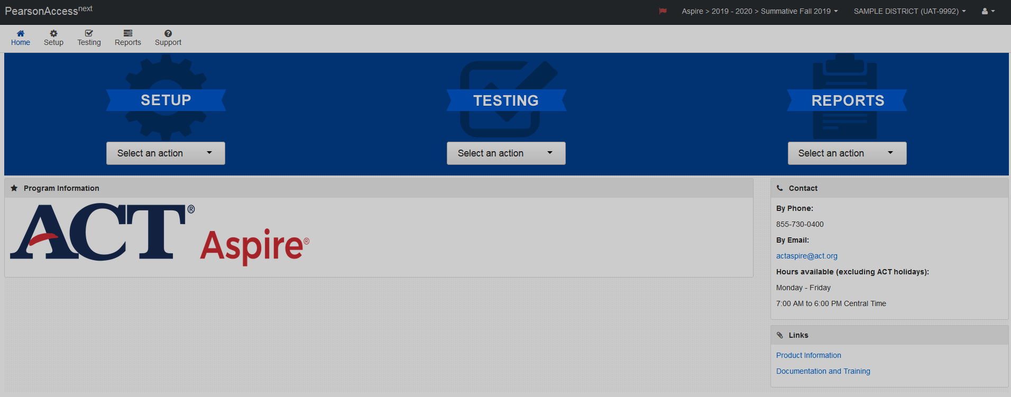
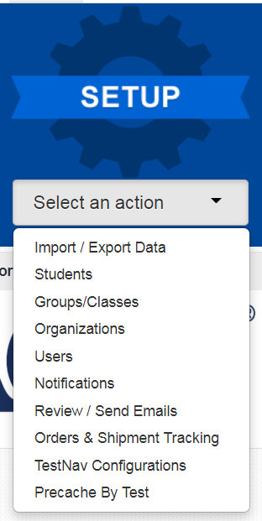



ACT Aspire Testing Process
1
Invite users Individually
Setup > users
Notes:
To create users individually, follow these steps:
From the Setup menu, select “Users”

Slide 12
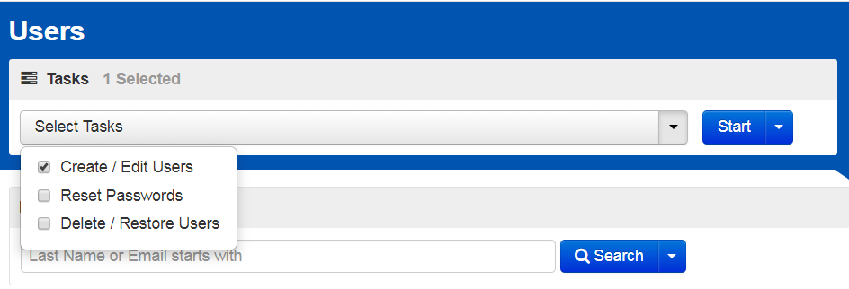
ACT Aspire Testing Process
1
Invite users Individually
Setup > users > Create / edit users
Notes:
Select “Create/Edit Users” from the dropdown menu

Slide 13
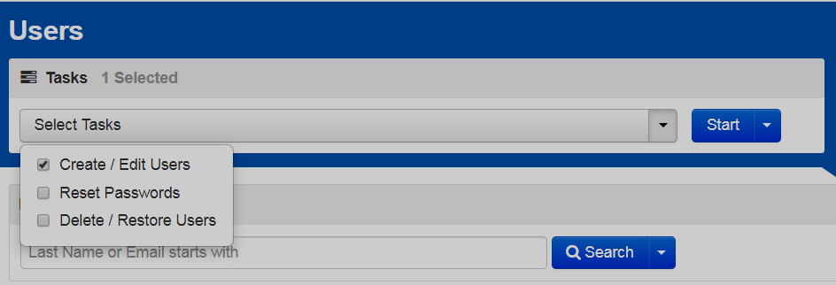
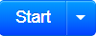
ACT Aspire Testing Process
1
Invite users Individually
Setup > users > Create / edit users
Notes:
Now click “Start.”

Slide 14
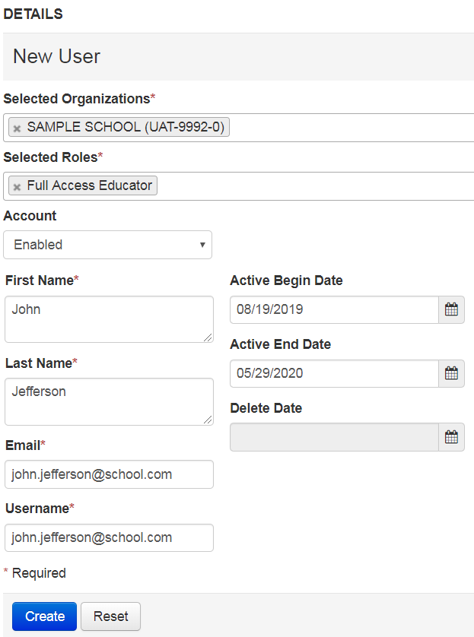
ACT Aspire Testing Process
1
Invite users Individually
Setup > users > Create / edit users > new user
Notes:
On the Create/Edit User task screen, you’ll add details about the new user, as shown. Users can be assigned to multiple schools, if they have roles at multiple organizations. It is recommended that users only have one role assigned to them, because adding multiple roles will limit the user’s access to that of the lowest-access role they’re assigned.
You can choose to add an Active Begin and End Date, but those are not required. Those dates indicate when a user will start having access and when their access will be cut off. If a user will need access to reports, please keep the reporting schedule in mind if you are selecting an End Date.

Slide 15


ACT Aspire Testing Process
1
Invite users Individually
Setup > users > Create / edit users > new user
Notes:
Click “Create” when complete.
The navigation process (using the menu, getting to the action screen, and then using the tasks buttons) is the same navigation structure that you’ll use throughout PearsonAccess^{next}.
Note that there are multiple ways of creating users – we’ve just reviewed adding users individually, but you can also add them by file import. The process steps are the same as adding students by file import.

Slide 16
ACT Aspire Testing Process
2
Student Registration Import
Invite Users
Student Registration Import
Personal Needs Profile
Delivery Date
Groups/Classes
Technology Setup & Configuration
Set Up Test Sessions
Receive Test Materials
Prepare Test Sessions
Print Tickets
Start Test Sessions
Administer
the Test
Post Test
Clean Up
Return Test Materials
2
Shared process
Paper
Online
Notes:
The next step in the process is importing students. First, ADE uploads students for the state in January based on the student enrollment data in AzEDS. After the ADE import, only newly enrolled students and any students missed in the ADE import will need to be added by the school or district.
Users with the Administration Test Coordinator and Test Coordinator roles are able to import student registration information.
There are two ways to add students. You can add students individually or by file import. Since it will be most common for you to add students by file import, that’s the process we’re going to outline in detail here. Using the Student Registration Import (or SRI), you’ll add student information and register them for tests at the same time.
If you individually add students, you’ll follow the same general process steps you followed when creating Users, just using the Students page. If you add a student individually, you’ll need to add their student information and in a separate step you’ll need to add their test registration. There are step-by-step guides in the Arizona ACT Aspire Support Page that walk you through this process.

Slide 17
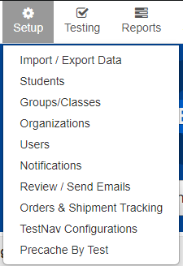
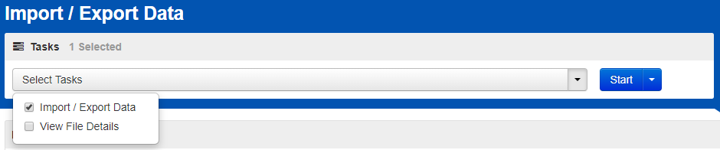
ACT Aspire Testing Process
2
Student registration import
Setup > Import / Export Data
Notes:
Use the resources under the Managing Students menu of the Arizona ACT Aspire Support page to guide you through the process for importing student registration information.
If you’re testing on paper, you’ll need to ensure your Student Registration Import (or SRI) is complete prior to the deadline listed in the ACT Aspire Schedule of Events.
To import an SRI file, go to the Setup menu, and select “Import/Export Data.” Select the “Import/Export Data” task.

Slide 18
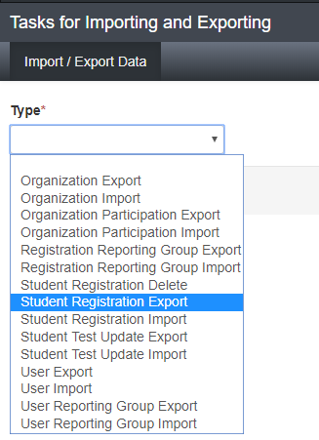
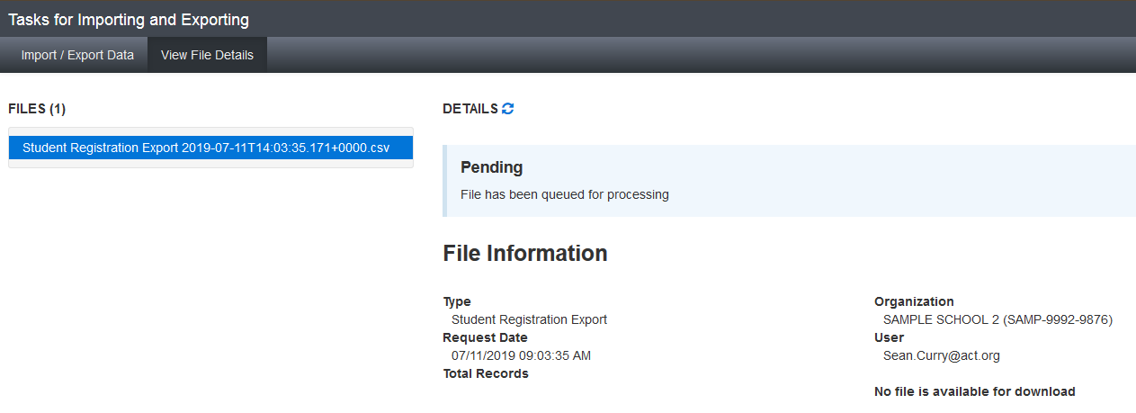


ACT Aspire Testing Process
2
Student registration import
Notes:
The first step is to complete a Student Registration Export file. To access the file layout header, on the tasks screen, select the “Student Registration Export” type, then click “Process.”
The file will show in pending status until the download is complete. You can click on the refresh button next to “Details” to see the status change, but you’ll also get an email when the file is Complete. When the file is ready to download, the status will change to Complete, and you will be able to download the file.
All files exported out of PearsonAccess^{next} are CSV files, so it will be important that you download and open the files in a way that preserves leading zeros and number formatting.

Slide 19
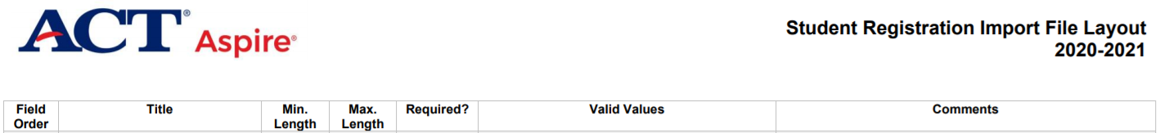
ACT Aspire Testing Process
2
Student registration import
Notes:
Download the SRI File Layout instructions from the Arizona ACT Aspire Support Page in the Managing Students section.
Use the SRI File Layout instructions to add all required information to the file. The layout instructions let you know which fields are required and what characters are accepted in each column of the student registration file.
When you have completed the file, save it as a CSV file format. You will get a prompt that asks whether you want to keep that file format or change it. Say “Yes” you want to keep the file using that format.
Save the file with a recognizable file name and in a location where you’ll be able to find it easily to import to the system.

Slide 20
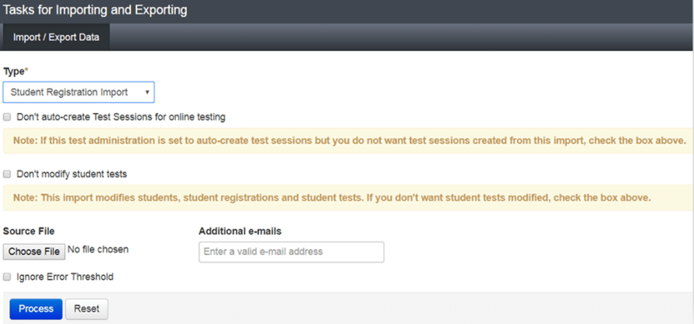
ACT Aspire Testing Process
2
Student registration import
Notes:
Once you have completed and saved the file, navigate back to PearsonAccess^{next}, and the Import/Export task screen. When importing the SRI file, review the text next to the checkboxes carefully and check them only if they apply to your file. In general, in your first import of students or when you're adding brand new students, you should NOT check any of the checkboxes.
Note that the checkboxes on the screen are different for different files. Every time you're importing or exporting a file, review the checkboxes carefully and make the appropriate selections.

Slide 21
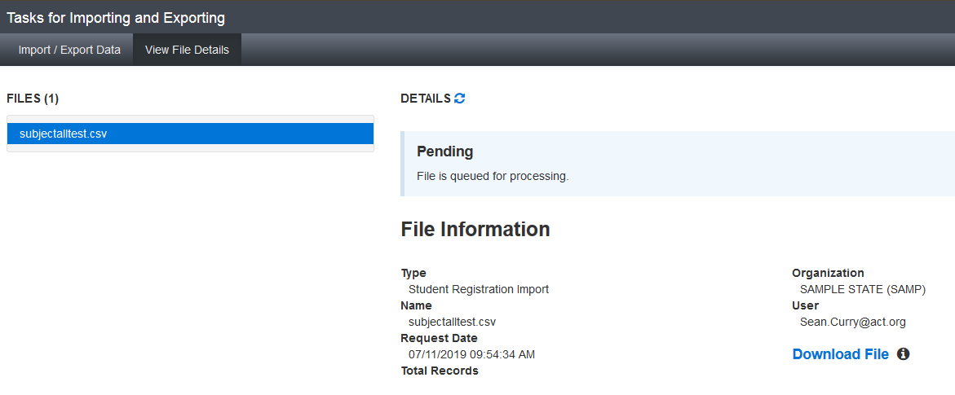

ACT Aspire Testing Process
2
Student registration import
Setup > Import / Export Data > Start / all tasks > student registration import
Notes:
If the file is done, it will change to Complete. If it isn’t done, wait a little longer and click refresh.
Again, your file will process, and you will see a notification when the file upload is Complete.
On the “Complete” page, you’ll also be notified if there are any errors in your file. The errors will show on the page, or you’ll be able to download the records in error, correct them, and upload them again.

Slide 22
ACT Aspire Testing Process
3
Personal needs profile
Invite Users
Student Registration Import
Personal Needs Profile
Delivery Date
Groups/Classes
Technology Setup & Configuration
Set Up Test Sessions
Receive Test Materials
Prepare Test Sessions
Print Tickets
Start Test Sessions
Administer
the Test
Post Test
Clean Up
Return Test Materials
3
Shared process
Paper
Online
Notes:
The next step is to complete the Personal Needs Profile information.
Personal Needs Profile (PNP) for each student determines what, if any, accommodations and supports are available for the student to use
Examples include extended time and text-to-speech
Refer to the Accessibility Supports Guide for guidance
As with most tasks in PearsonAccess^{next}, PNP information can be added in 2 ways, either by manually adding the information or by importing a file. Since the file import process is so similar no matter what type of file you're importing, we're covering the process for manually adding student PNP information.

Slide 23
ACT Aspire Testing Process
3
Personal needs profile – manual entry
Setup > students
Notes:
We’ll start adding PNP information via manual entry:
Go to the Setup Menu, then click on “Students”

Slide 24
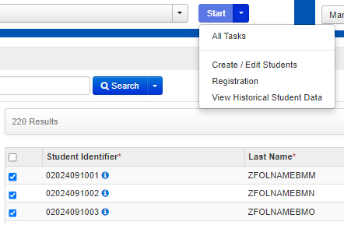
ACT Aspire Testing Process
3
Personal needs profile – manual entry
Setup > students
Notes:
Select a student by checking the box next to their name
Select Start > All Tasks

Slide 25
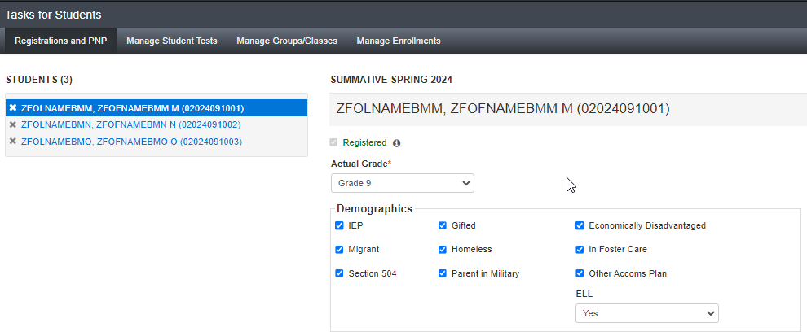
ACT Aspire Testing Process
3
Personal needs profile – manual entry
Registrations and PNP
Notes:
On the Tasks for Students screen, in the Registrations and PNP tab, select the student you would like to edit.

Slide 26
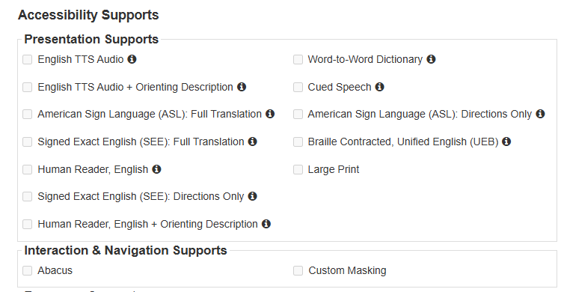
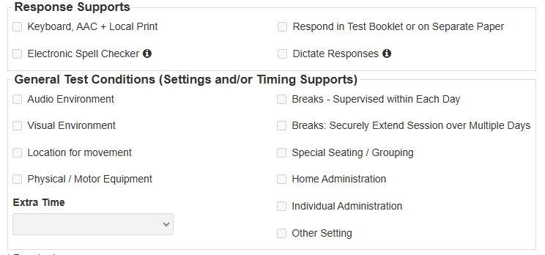
ACT Aspire Testing Process
3
Personal needs profile – manual entry
Registrations and PNP
Registrations and PNP
Notes:
Select the appropriate Accessibility Supports from the categories on the screen, then “Save.”
You can also use the file import process to add PNP information to multiple students at once. That file process is very similar to all other file import processes.

Slide 27
ACT Aspire Testing Process
4
Delivery Date – Paper Testing Only
Invite Users
Student Registration Import
Personal Needs Profile
Delivery Date
Groups/Classes
Technology Setup & Configuration
Set Up Test Sessions
Receive Test Materials
Prepare Test Sessions
Print Tickets
Start Test Sessions
Administer
the Test
Post Test
Clean Up
Return Test Materials
4
Shared process
Paper
Online
Notes:
If your school is testing students on paper, you'll receive paper materials according to the dates published in the Schedule of Events on the Arizona ACT Aspire Support Page.

Slide 28
ACT Aspire Testing Process
5
Set up Groups/Classes
Invite Users
Student Registration Import
Personal Needs Profile
Delivery Date
Groups/Classes
Technology Setup & Configuration
Set Up Test Sessions
Receive Test Materials
Prepare Test Sessions
Print Tickets
Start Test Sessions
Administer
the Test
Post Test
Clean Up
Return Test Materials
Shared process
Paper
Online
Notes:
Setting up Groups or Classes is an optional activity for Online Testing.
The primary purpose of having groups or classes is to assist you in creating test sessions.
This task may be completed by the Administration Test Coordinator and Test Coordinator roles.

Slide 29

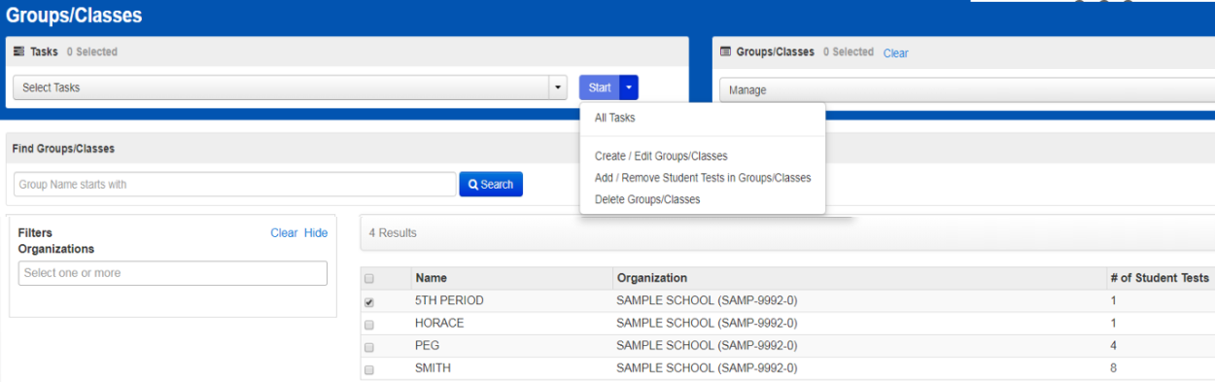


ACT Aspire Testing Process
5
create groups/classes
Setup > groups / classes
Notes:
Start by going to Setup > Groups/Classes
Click the dropdown to the right of the “Start” button. Click Create / Edit Groups/Classes.

Slide 30
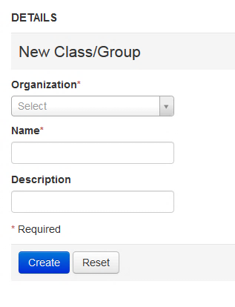
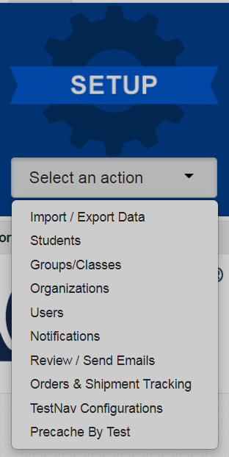
ACT Aspire Testing Process
5
create groups/classes
Setup > groups / classes
Notes:
On the details screen, complete all required fields.
Then click “Create.”

Slide 31
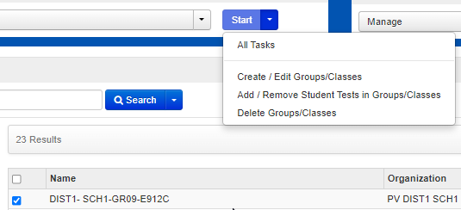
ACT Aspire Testing Process
5
Groups – Add by groups/classes
Setup > Groups/Classes
Notes:
Now that you’ve created your groups, you’re going to add students to the group. There are three ways to do that; the first is by groups/classes, where you pick a group and add the specific students to that group.
From the Setup menu, select “Groups/Classes.”
Select the checkbox next to the Group/Class for which you want to add or remove students.
Click “Start,” then “Add / Remove Student Tests in Groups/Classes.”

Slide 32
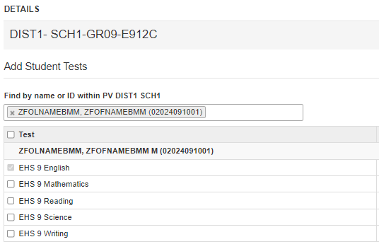
ACT Aspire Testing Process
5
Groups – Add by groups/classes
Setup > Students > Start > add / remove student tests in groups/classes
Notes:
Type the student name or ID into the Find box and select the student to add.
Click the checkbox next to the desired student test to add to the group/class.
You will also see a "Select All" Checkbox on this screen. That will allow you to select all students to add to the new group/class, if you're adding many students at once.
Then click “Save.”
You can add multiple students to the “Find” box and can check the box next to multiple tests.

Slide 33
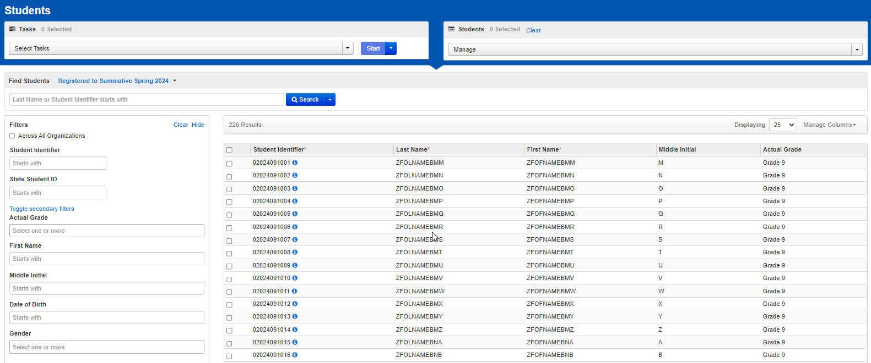
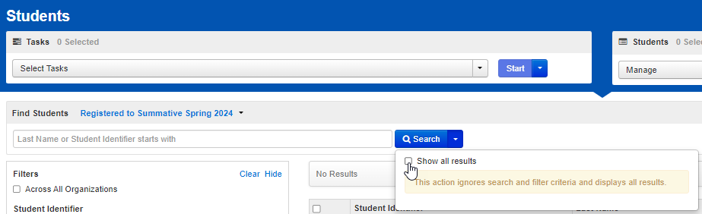
ACT Aspire Testing Process
5
Groups – Add by student
Setup > Students
Notes:
The second way to add students to groups/classes is by Student.
Go to Setup and select “Students.”
On the Students page, click the “Show all results” box on the Search menu.
Select the students you want to edit by placing a check in the check box.

Slide 34
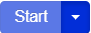


ACT Aspire Testing Process
5
Groups – Add by student
Setup > Students
Notes:
After students are selected, click “Start” then “All Tasks.”
Then, on the Tasks for Students page, click the Manage Groups/Classes tab.

Slide 35
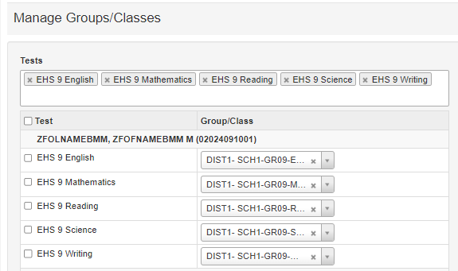
ACT Aspire Testing Process
5
Groups – Add by student
Setup > Students > Start > All tasks
Notes:
A list of students will appear. Use the dropdown menu for each test subject to assign a group to the student.
The third way to add students to groups is via the Student PNP & Test Information file, which we reviewed in the PNP section. The process is the same when adding students to groups as it is when adding student PNP information.

Slide 36
ACT Aspire Testing Process
6
Technology Setup & Configuration
Invite Users
Student Registration Import
Personal Needs Profile
Delivery Date
Groups/Classes
Technology Setup & Configuration
Set Up Test Sessions
Receive Test Materials
Prepare Test Sessions
Print Tickets
Start Test Sessions
Administer
the Test
Post Test
Clean Up
Return Test Materials
6
Shared process
Paper
Online
Notes:
When you’re administering tests online, there are additional Technology Setup and Configuration activities to complete. A separate webinar is available about technical readiness that dives into detail about the technology setup steps. It is recommended that Technical Coordinators, Administration Test Coordinators, and Test Coordinators watch that webinar.

Slide 37
ACT Aspire Testing Process
7
Setup Test Sessions
Invite Users
Student Registration Import
Personal Needs Profile
Delivery Date
Groups/Classes
Technology Setup & Configuration
Set Up Test Sessions
Receive Test Materials
Prepare Test Sessions
Print Tickets
Start Test Sessions
Administer
the Test
Post Test
Clean Up
Return Test Materials
Shared process
Paper
Online
Notes:
Setting up Test Sessions is an activity for online testing. Sessions do not need to be set up for students testing on paper.
This task may be completed by the Administration Test Coordinator, Test Coordinator, and Full Access Educator roles.
*TestNav Configurations, which are part of Technology Setup & Configuration, should be completed prior to creating test sessions. There is a separate webinar covering technical readiness, posted to the Arizona ACT Aspire Support webpage.
In addition, student PNP selections should be made in PearsonAccess^{next} prior to placing students in their test sessions.
Sessions can be created in bulk by file import or individually. The file import method uses the Student PNP & Test Information file import process, similar to the import process for all other files. Now we’ll talk through the method for adding test sessions individually.

Slide 38
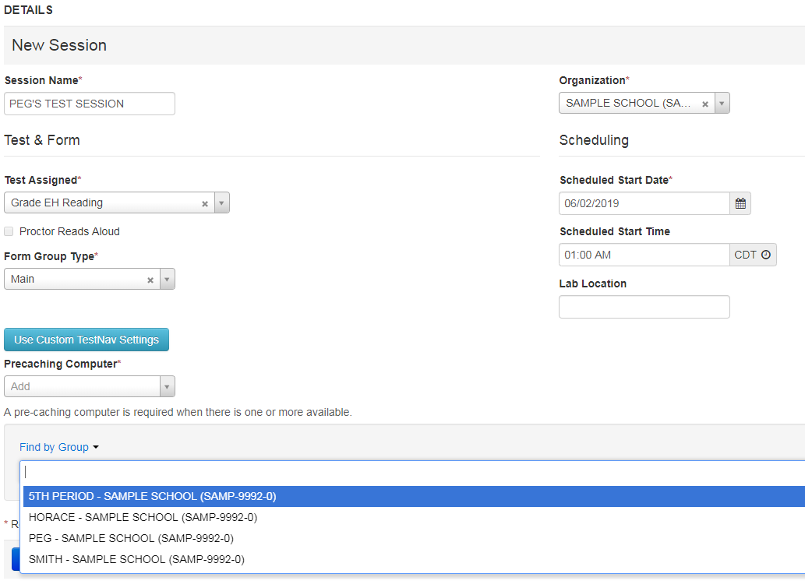
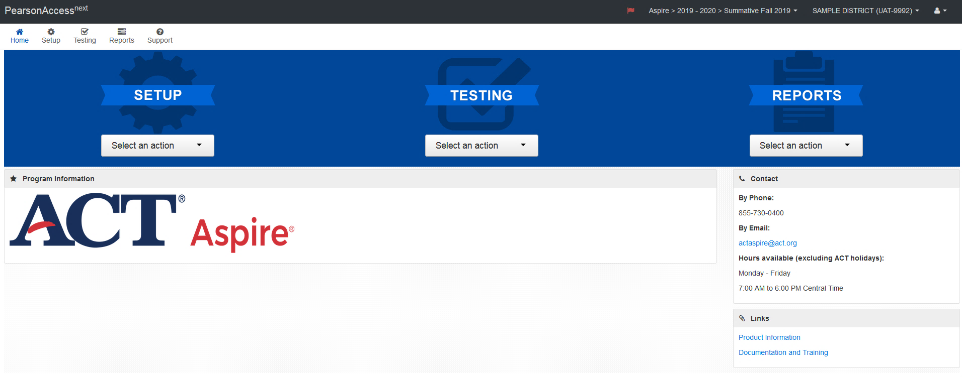
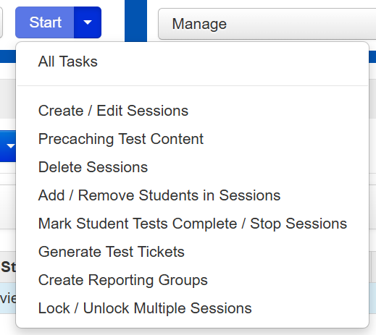
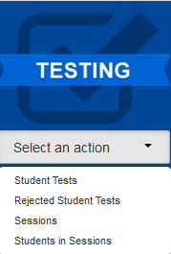
ACT Aspire Testing Process
7
Setup Test Sessions – individually
Testing > session
Notes:
Select “Sessions” from the Testing menu. Use the Select Tasks dropdown and select “Create/Edit Sessions.”
On the Create/Edit Sessions screen, you’ll need to fill in all required fields and add students, either individually or by group, if you have created groups. To toggle between adding students individually or adding groups to a session, use the “Find by…” dropdown on the task screen.
Click “Save” when finished.

Slide 39
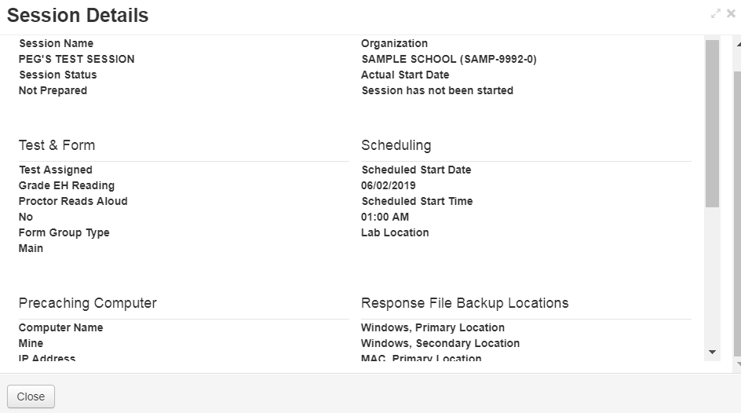
ACT Aspire Testing Process
7
Setup Test Sessions – individually
Testing > sessions > session details
Notes:
To verify your session information, navigate via the Testing menu to “Sessions.”
Then click the information icon next to the session name to view details about the test session.

Slide 40
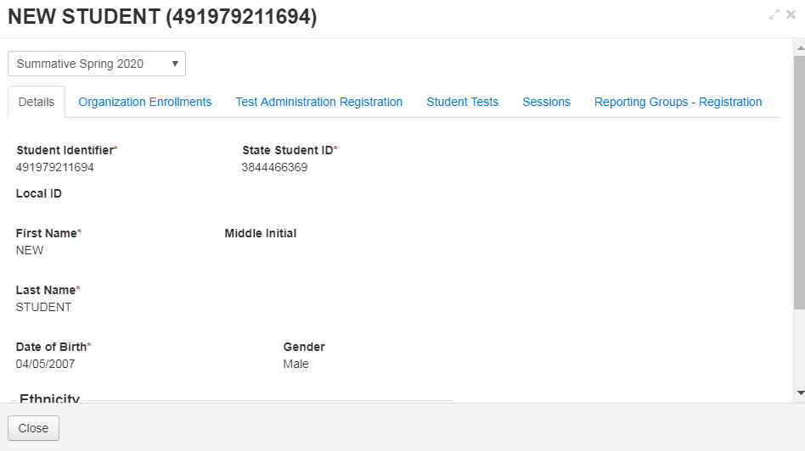
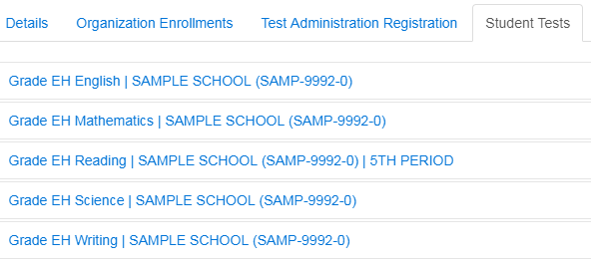
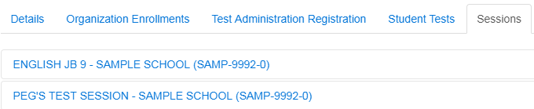
ACT Aspire Testing Process
7
Setup Test Sessions – individually
Setup > students > session details
Notes:
The information icon by the student name will also show their registration and session information.

Slide 41
ACT Aspire Testing Process
9
8
Receive Test Materials
Invite Users
Student Registration Import
Personal Needs Profile
Delivery Date
Groups/Classes
Technology Setup & Configuration
Set Up Test Sessions
Receive Test Materials
Prepare Test Sessions
Print Tickets
Start Test Sessions
Administer
the Test
Post Test
Clean Up
Return Test Materials
8
Shared process
Paper
Online
Notes:
Your test materials received in district date is available in the Schedule of Events document.
Test materials are delivered to the shipping address as listed in PearsonAccess^{next}.

Slide 42





ACT Aspire Testing Process
8
Receive Test Materials
Within 24 hours of delivery:
Check Materials
Reseal boxes
Protect materials
Notes:
Within 24 hours of delivery
Check to ensure all items on packing slip are accounted for
Check test booklet serial numbers against the packing slip
Count test booklets and answer documents
Notify Pearson of any discrepancies or concerns
Save the boxes used for shipping – they will be used for the return shipment
Reseal boxes and lock them in secure storage
Protect materials from damage, theft, loss, or any conditions that could allow prior access or knowledge of test content
Please note that hard copies of the Test Coordinator’s Manual and Room Supervisor Manuals are not shipped to districts or schools. The manuals may be accessed electronically.

Slide 43
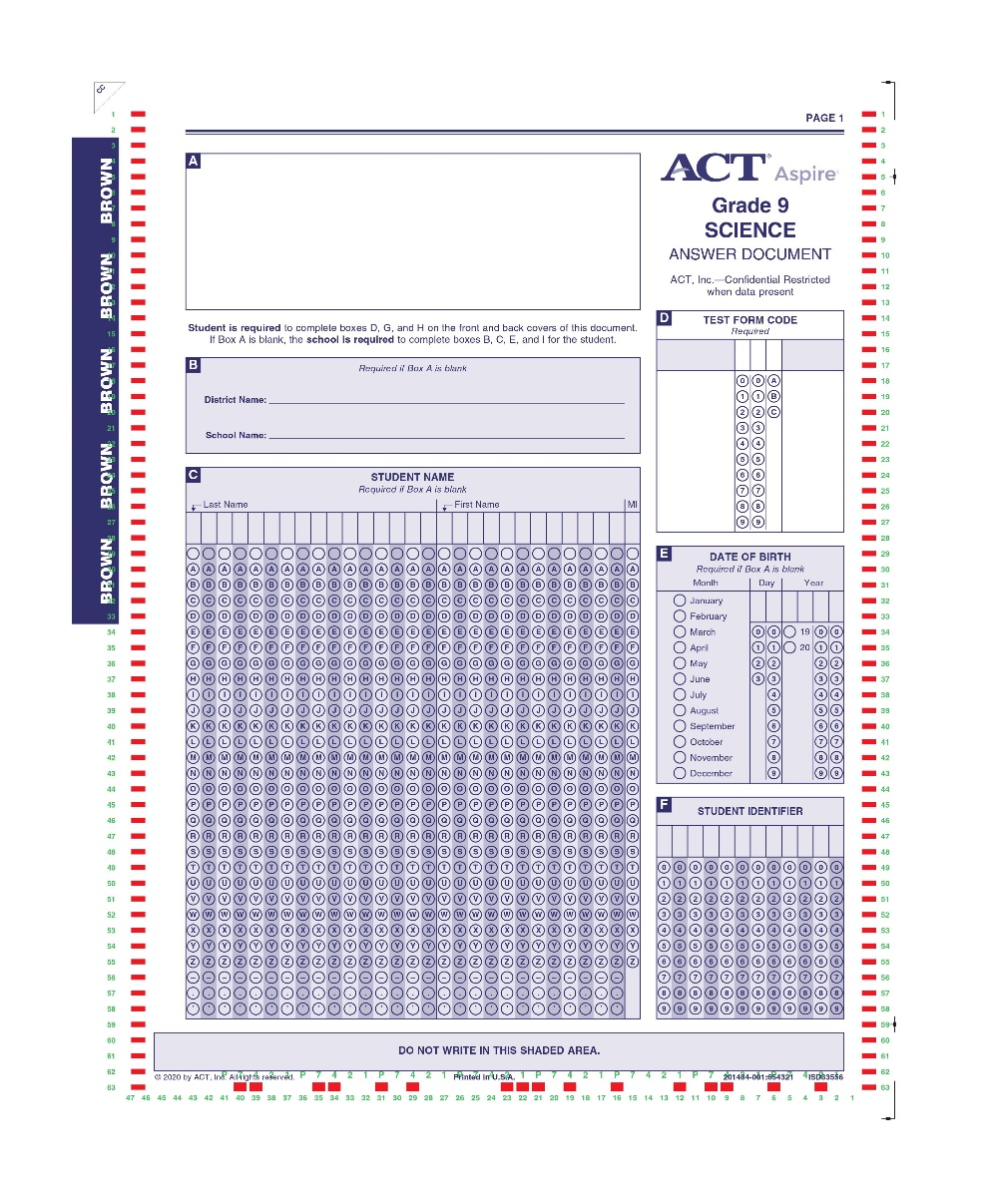
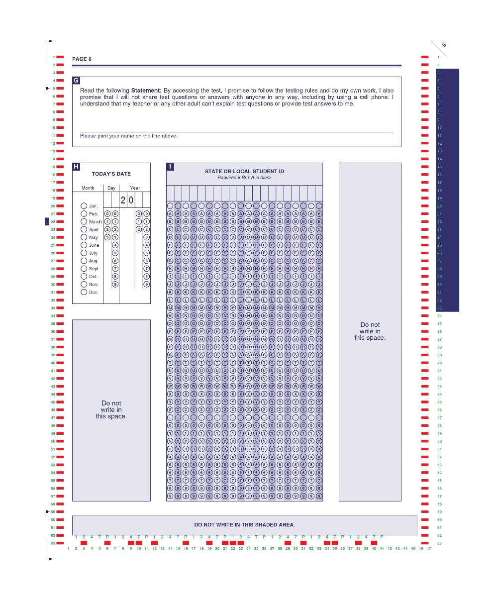
ACT Aspire Testing Process
8
Prepare test materials
Notes:
There will be some preparation steps needed when you receive paper testing materials. We recommend completing these steps prior to test day. You may find it easiest to complete these steps at the same time as checking in materials, so you don’t need to take the materials out of secure storage prior to test morning.
You’ll need to:
Affix barcode/pre-id labels to each student’s answer document for every test.
Grid the required information on blank answer documents if a student doesn’t have a barcode label
You may also choose to sort materials by testing room, so they’re easier to distribute on test day.

Slide 44
ACT Aspire Testing Process
9
Prepare Test Sessions
Invite Users
Student Registration Import
Personal Needs Profile
Select Delivery Date
Groups/Classes
Technology Setup & Configuration
Set Up Test Sessions
Receive Test Materials
Prepare Test Sessions
Print Tickets
Start Test Sessions
Administer
the Test
Post Test
Clean Up
Return Test Materials
9
Shared process
Paper
Online
Notes:
When you’re testing online, you’ll need to prepare your test sessions prior to test day. This task can be completed by the Administration Test Coordinator, Test Coordinator, Room Supervisor, and Full Access Educator roles.

Slide 45
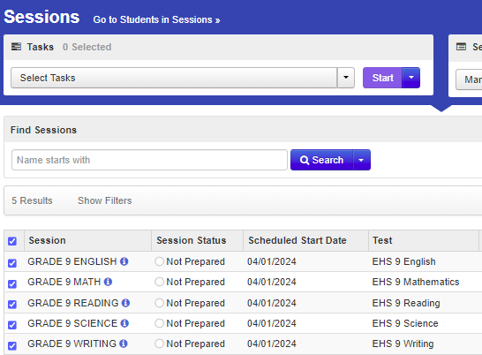


ACT Aspire Testing Process
9
Prepare Test Sessions
Notes:
From the Testing menu, navigate to the Sessions page.
Select the sessions you wish to prepare.

Slide 46
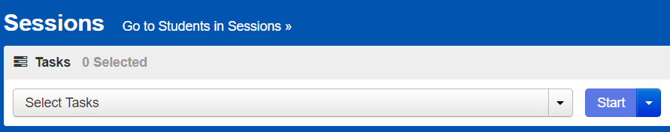
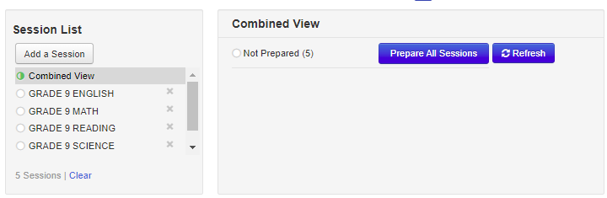
ACT Aspire Testing Process
9
Prepare Test Sessions
Notes:
Then, navigate to the Students in Sessions page by clicking on the “Go to Students in Sessions” button on the Sessions page, using the Tasks menu, or using the main Testing menu.
In the Session List on the left side of the screen, select the session you want to prepare, or click “Combined View.”
If you’ve selected “Combined View,” click on the “Prepare All Sessions” button. If you’ve just selected one session, click on the “Prepare Session” button.

Slide 47
ACT Aspire Testing Process
10
Print tickets
Invite Users
Student Registration Import
Personal Needs Profile
Select Delivery Date
Groups/Classes
Technology Setup & Configuration
Set Up Test Sessions
Receive Test Materials
Prepare Test Sessions
Print Tickets
Start Test Sessions
Administer
the Test
Post Test
Clean Up
Return Test Materials
10
Shared process
Paper
Online
Notes:
Next, you’ll need to print student testing tickets. This can be completed by the Administration Test Coordinator, Test Coordinator, Room Supervisor, and Full Access Educator roles.
There are a few ways to print student testing tickets:
Print all tickets for a single session
Print selected tickets for a single session
Print all tickets for multiple sessions

Slide 48
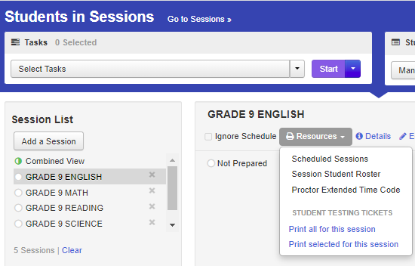
ACT Aspire Testing Process
10
Print tickets for a single session
TESTING > STUDENTS IN SESSIONS
Notes:
To print all examinees in a single session, an individual examinee, or a small group of examinees, navigate to the Students in Sessions page after selecting the session you’d like to print tickets for from the Sessions screen.
Select the desired session in the Session List and navigate to the Resources dropdown menu.
If you’re printing all tickets for the selected session, use the “Print all for this session” button.
If you’re printing only selected tickets for the session, use the “Print selected” button. Before you use the “Print selected” button, you’ll need to select the specific students from the Students panel on the Students in Sessions page.

Slide 49
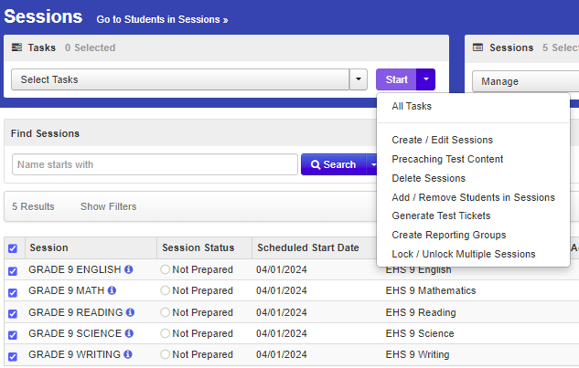
ACT Aspire Testing Process
10
Print tickets for Multiple sessions
Notes:
To print testing tickets for multiple sessions, navigate to the Sessions page from the Testing Menu. Select the sessions for which you would like to print testing tickets.
Then use the Start menu to select the “Generate Test Tickets” task.

Slide 50
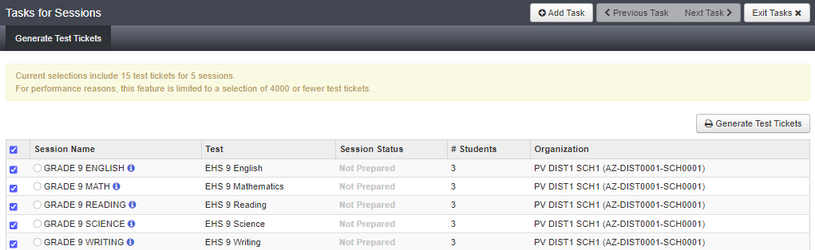
ACT Aspire Testing Process
10
Print tickets for Multiple sessions
Notes:
On the Generate Test Tickets task screen, confirm the selection of all the sessions for which you want to print testing tickets.
Then, select the “Generate Test Tickets” button to create the testing tickets for each session. A PDF of the testing tickets will be generated and sent to your downloads queue.
Keep in mind: before you print, make sure your print settings are not set to print two-sided. Each testing ticket will print on one page, with a header sheet separating each session.

Slide 51
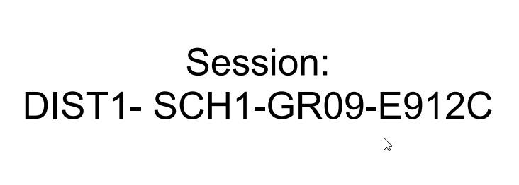
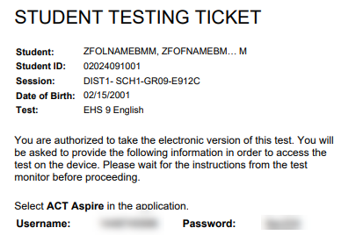
ACT Aspire Testing Process
10
Sample Test Tickets and Header Sheet
Notes:
Header sheets separate test sessions. Student testing tickets may be printed one per page or up to 6 tickets per page in a list or grid format.
This graphic shows an example of the header sheet and a single testing ticket.

Slide 52
ACT Aspire Testing Process
11
Start Test Sessions
Invite Users
Student Registration Import
Personal Needs Profile
Delivery Date
Groups/Classes
Technology Setup & Configuration
Set Up Test Sessions
Receive Test Materials
Prepare Test Sessions
Print Tickets
Start Test Sessions
Administer
the Test
Post Test
Clean Up
Return Test Materials
11
Shared process
Paper
Online
Notes:
Finally, on the morning of testing, test sessions will need to be started and unlocked. This can be completed by the Administration Test Coordinator, Test Coordinator, Room Supervisor, and Full Access Educator roles.
Once each session is started and immediately before testing begins, when students are admitted to the test room and completely prepared for testing to begin, Room Supervisors can unlock the test session they’re responsible for.
Starting a test session marks it as In Progress.

Slide 53
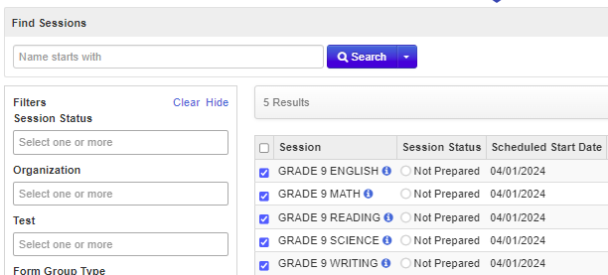
ACT Aspire Testing Process
11
Start test sessions
Notes:
Navigate to the Sessions page from the Testing Menu. Select the session or sessions you’d like to start.
Note that on the Sessions screen, you can search for specific sessions. In the Search dropdown menu, select “Show all results” to see a list of all sessions. You can also apply a filter by entering additional details.

Slide 54
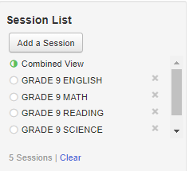
ACT Aspire Testing Process
11
Start test sessions
Notes:
Use the “Go to Students in Sessions” link on the Sessions screen to navigate to the Students in Sessions page.
On the Students in Sessions page, use the Session List to select the session you'd like to start or use “Combined View” to start all sessions. Then click “Start Session(s).”

Slide 55
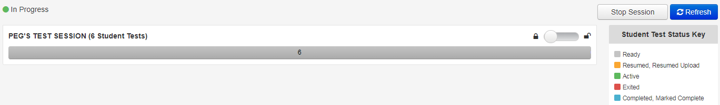
ACT Aspire Testing Process
11
Unlock test sessions
Notes:
The final step to launch testing is unlocking sessions. Before examinees can log into the test session in TestNav, the test session must be unlocked.
Sessions can only be unlocked individually. Tests should not be unlocked for students who are not present for testing.
From the Students in Sessions screen, use the slider to unlock each session.

Slide 56

ACT Aspire Testing Process
11
Unlock test sessions
Notes:
The Student Test Status changes from Ready with a padlock, to Ready (no padlock).
If this step isn’t performed, examinees can’t access the test session. An error message will appear indicating it is locked.
Leave PearsonAccess^{next} running on the Room Supervisor’s computer during the test session so Room Supervisors can monitor students’ testing status.
Tip: An examinee’s test session should be locked if the examinee is provided a break.

Slide 57
ACT Aspire Testing Process
12
Administer the Test
Invite Users
Student Registration Import
Personal Needs Profile
Select Delivery Date
Groups/Classes
Technology Setup & Configuration
Set Up Test Sessions
Receive Test Materials
Prepare Test Sessions
Print Tickets
Start Test Sessions
Administer
the Test
Post Test
Clean Up
Return Test Materials
12
Shared process
Paper
Online
Notes:
Let’s review how to administer the test. Always use the appropriate Room Supervisor Manual to assist you on test day. There is a separate Room Supervisor Manual for online testing and for paper testing.

Slide 58

ACT Aspire Testing Process
12
Room Supervisor’s Role
Notes:
Room Supervisors and, if applicable, proctors, are responsible for a single testing room. Whether testing online or on paper, Room Supervisors are responsible for:
Ensuring testing rooms are set up according to ACT guidelines for each testing mode listed in the Room Supervisor’s Manual
Admitting and seating examinees
Note that ACT recommends planning test room rosters in advance, and you can plan seating charts in advance, if you choose.

Slide 59


ACT Aspire Testing Process
12
Room Supervisor’s Role
Notes:
Room Supervisors are also responsible for:
Reading the verbal instructions to examinees, using the appropriate Room Supervisor Manual
Monitoring the testing room throughout the test
Timing the test appropriately, strictly following the timing outlined in the Room Supervisor Manual

Slide 60

ACT Aspire Testing Process
12
Administer the test Online
Student Login
ACT Aspire
Notes:
When administering the ACT Aspire test online:
The student will use their Student Testing Ticket to login to TestNav to begin testing
If students are having trouble logging in to TestNav, use the "show password“ button to help administrators ensure that passwords are being entered correctly
Room Supervisors should follow test day instructions in the appropriate Room Supervisor Manual, which will also include the verbal instructions that direct students' what steps to take.

Slide 61

ACT Aspire Testing Process
12
Administer the test Online
Student Test Management
Notes:
Students’ progress can be monitored on the Students in Sessions screen

Slide 62
ACT Aspire Testing Process
12
Administer the test online
Student Test Management
Notes:
Different statuses may require action by the Room Supervisor.
The Ready status indicates the Student has not launched the test yet. It may require the Room Supervisor to provide the student testing ticket so the test can be launched.

Slide 63
ACT Aspire Testing Process
12
Administer the test online
Student Test Management
Notes:
An Active status indicates a student is testing.

Slide 64
ACT Aspire Testing Process
12
Administer the test online
Student Test Management
Notes:
An Exited status informs that the student signed out of TestNav. This will require the Room Supervisor to resume the test so the student can finish testing.

Slide 65
ACT Aspire Testing Process
12
Administer the test online
Student Test Management
Notes:
A Completed status informs that the student has submitted the test.

Slide 66

ACT Aspire Testing Process
12
Administer the test online
Student Test Management
Notes:
Room Supervisors can change a student’s test status by selecting individual students or multiple students, if needed. The Room Supervisor will need to change a student’s test status when resuming a student test.

Slide 67


ACT Aspire Testing Process
12
Administer the test online
Student Test Management
Notes:
First, select the students, then select “All Tasks” from the Start menu.

Slide 68



ACT Aspire Testing Process
12
Administer the test online
Resume an exited test
Notes:
Click “Resume Student Tests” on the Tasks for Students in Sessions screen.
Next, click the checkbox for the student that needs to resume the test. Only students with an eligible status will have a clickable checkbox.
Then, click “Resume.” A green Success message will appear, and the Student Test Status will change to Resumed.

Slide 69

ACT Aspire Testing Process
12
Administer the test online
stop a test session
Notes:
To stop a session:
First, make sure all student tests are in Completed or Marked Complete status. Then click “Stop Session.”

Slide 70

ACT Aspire Testing Process
12
Administer the test online
stop a test session
Notes:
The session will change from In Progress to Stopped and the “Stop Session” button will change to a “Restart Session” button.

Slide 71

ACT Aspire Testing Process
12
Administer the test On Paper
Notes:
For paper testing, Room Supervisors and proctors will also:
Distribute testing materials by handing each student’s test book and answer document directly to them. Don’t pass these materials down rows.
Collect materials when testing is complete, confirm that all materials have been returned, and deliver them to the Test Coordinator to be securely stored or packaged for return.

Slide 72
ACT Aspire Testing Process
13
Post Test Clean Up
Invite Users
Student Registration Import
Personal Needs Profile
Delivery Date
Groups/Classes
Technology Setup & Configuration
Set Up Test Sessions
Receive Test Materials
Prepare Test Sessions
Print Tickets
Start Test Sessions
Administer
the Test
Post Test
Clean Up
Return Test Materials
13
Shared process
Paper
Online
Notes:
Now, let’s look at post test cleanup.

Slide 73
ACT Aspire Testing Process
13
Post Test Clean Up
Record irregularities in PearsonAccess^{next}
Test irregularities should be reported as soon as possible, ideally within 24 hours of the incident
Follow instructions in the Room Supervisor Manual and the Test Coordinator Manual
Notes:
Report any testing irregularities that occurred during testing using the irregularity reporting tool in PearsonAccess^{next}. Testing irregularities for both online and paper testing should be reported as soon as possible, ideally within 24 hours of the incident.
To record irregularities, follow instructions in the Room Supervisor Manual and the Test Coordinator Manual.

Slide 74
ACT Aspire Testing Process
14
Return test materials
Invite Users
Student Registration Import
Personal Needs Profile
Select Delivery Date
Groups/Classes
Technology Setup & Configuration
Set Up Test Sessions
Receive Test Materials
Prepare Test Sessions
Print Tickets
Start Test Sessions
Administer
the Test
Post Test
Clean Up
Return Test Materials
14
Shared process
Paper
Online
Notes:
Now, let’s look at the process for returning paper test materials after testing.

Slide 75


ACT Aspire Testing Process
14
Return test materials
Within 48 hours after testing:
Protect Materials
Use Boxes and Labels Provided
Follow Instructions in Manual
Notes:
Return materials according to the guidance published in the ACT Aspire Schedule of Events.
Keep materials locked and stored securely until they are shipped.
Use the boxes and shipping labels provided.
Follow instructions in the Test Coordinator Manual and Room Supervisor-Paper Manual for returning scorable and non-scorable materials.

Slide 76

Questions?
We’re here to help!
Pearson Customer Support
Phone: 1.888.705.9421 Option 4 (ACT Aspire), 7:00 a.m. – 7:00 p.m., central time, Monday through Friday
Notes:
This concludes the ACT Aspire Test Administration training. If you have any questions, please contact us at the number provided on this slide.

